Slide 1
SAP Gateway
Day 5
<Trainer>
Capgemini, India

Slide 2
SAP Gateway Day 5 - Agenda
Types of CDS Views
CDS with Input Parameters
CDS View on View

Slide 3
Type of CDS Views
CDS View with Input Parameters
CDS View Extensions
View-on-View
CDS View without Input Parameters

Slide 4
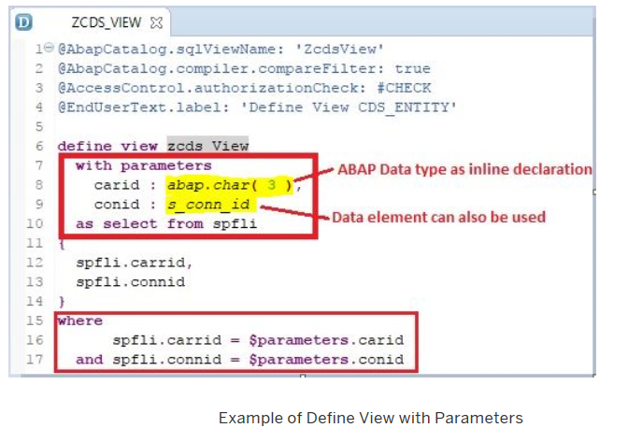
Type of CDS Views
CDS View with input parameters
To create Views with parameters key word used is With PARAMETER.
Comma-separated list of scalar input parameters and their corresponding type is to be mentioned.
Supported parameter types are as follows:
Predefined data type like abap.char(char_len)
Name of a data element

Slide 5
Demo
CDS View with Input Parameter

Slide 6
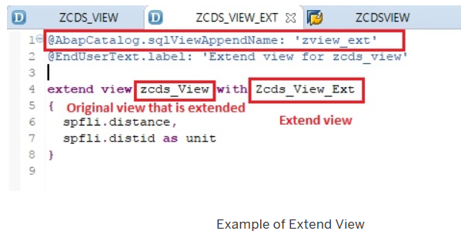
Type of CDS Views
CDS View Extensions
A CDS view can be extended by adding new fields .
To extend a CDS Base view, the key word used is EXTEND VIEW .
In the extended view, mention the new fields to be added separated by comma.

Slide 7
Demo
Create Base CDS View
Extend the above CDS View

Slide 8
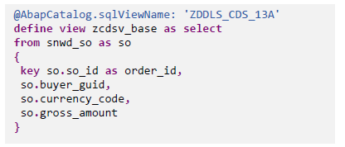
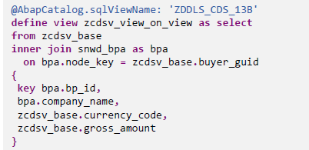
Type of CDS Views
View-on-View
Another important type of CDS view is View on View.
You can create CDS view on another CDS View(called as the Base View).
There is no restriction on the number of layers.

Slide 9
Demo
Create Base CDS View
Create View on the above Base View

